Slide 1
Zomato Analytics - 2024
PRESENTATION BY
18/02/2024
Anusha Sundaram

Slide 2
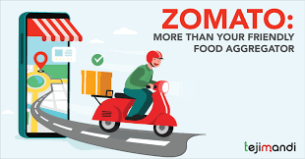
Interesting Facts
Initially named as “FOODIEBAY”.
It was renamed as “ZOMATO” in November 2010.
Parent company is “Info Edge”.
It belongs to FOOD and RESTAURANT GUIDE sector.
Zomato provides information and reviews on restaurants, including images of menus where the restaurants doesn’t have its own website.
Zomato is the best way or option to search and discover places to eat.

Slide 3

Problem Statement
Zomato wants to analyse the places in which they can set up its new restaurants.
For this, we have addressed missing values in Cuisines section to enhance data integrity.
This dataset allows for an in-depth understanding of Zomato’s market presence and operational scope.
Insights from user demographics and order volumes are key to optimizing marketing strategies and expanding product offerings.
Hence, in further slides we will draw conclusions from the data analysis and identify potential areas for Zomato to understand the Market.

Slide 4

Data Overview
Total Restaurants: 9551, Average Rating of all the restaurants across the world: 2.89, Average Cost for Two: $10.06 (combined currencies of different countries and converted them to common currency USD), Total Votes: 14,98,645.
Services are provided in 15 Countries and 141 Cities worldwide.
Various Cuisines are served across regions.

Slide 5


Analytical Approach and Tools
Data Cleaning and Enrichment: Utilized functions like Vlookup to match country code and countries, Mode to fill the blank rows of cuisines, concatenate function to merge abbreviation of currency with amount, Used exchange rate to convert all the cost to USD (common currency), the 0’s in Average cost(In Dollars) Column are replaced with blanks and Isblank formula is used to calculate the Average cost for two($).
Descriptive Analysis: Employed Pivot tables for summarizing key metrics and identifying countries where the new restaurant can be set up.
Visualization: Created dynamic charts and dashboard for data representation, enabling interactive data exploration.

Slide 6
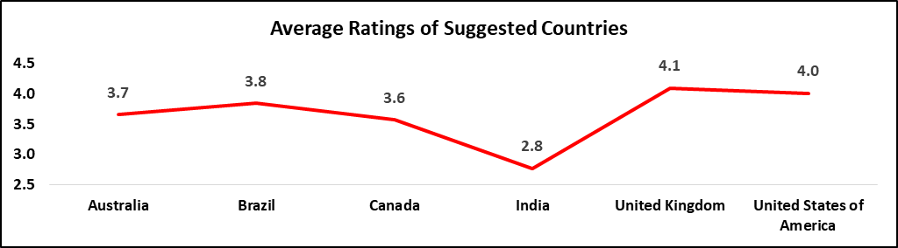
Considerations to open New Restaurants in the suggested locations
From the given data, several points such as Online delivery & Table booking, Price Range, Average cost, Ratings are all considered to suggest location to open New restaurant.
Average rating of the suggested Countries is 2.8 which is quiet low and if new restaurants are opened in these locations, there is huge business opportunity and growth.
So, the Countries suggested from above points are Australia, Brazil, Canada, India, UK, USA.

Slide 7
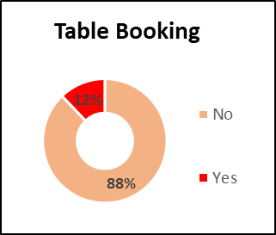
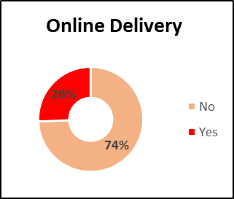
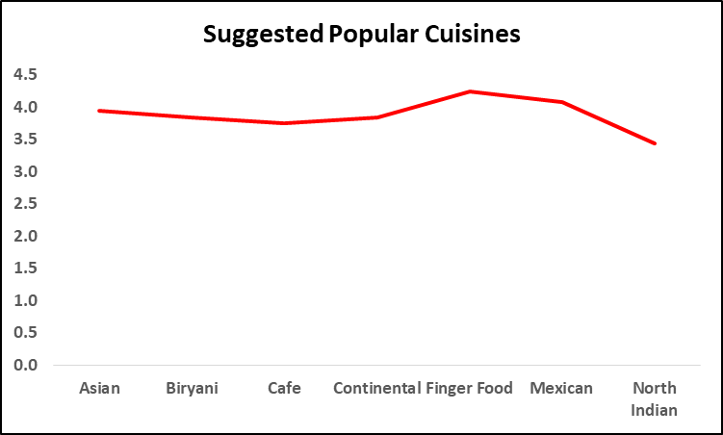
Analytical Approach
Here, we can see the data based on the aforementioned matrix:
As per the data given, the ones that doesn’t have Table booking and Online delivery has negative impact on ratings.
The restaurants that provides Table booking, Online delivery and that has high ratings serves all the mentioned Cuisines as shown in the Line chart.
Asian, Biryani, Cafe, Continental, Finger Food, Mexican and North Indian are the popular cuisines with Average rating as 3.6 which is pretty good, in the countries Australia, Brazil, Canada, India, UK, USA that is been suggested.
Hence, it is a good idea to have these famous cuisines in those countries where the restaurants are going to be set up.

Slide 8
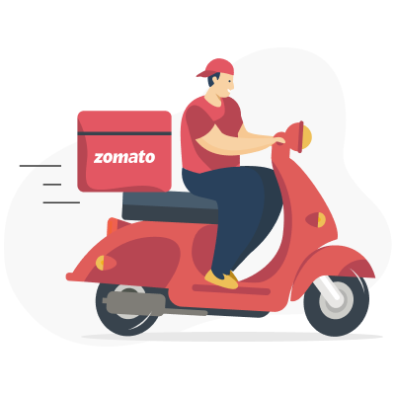
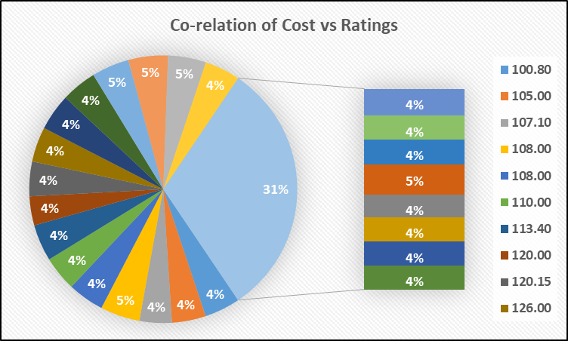
Food Expenditure Analysis
From the given data and analysis, we see that people are happy to spend for food and even if the cost is higher, rating isn’t affected because of it.
People prefer varied cuisines and the restaurants that has Online and Table booking facility rather than the ones that do not provide all these.

Slide 9

Strategic Recommendations
From each recommendation given we can understand the below points to set up new restaurants
Analyzing Trends in different countries with existing restaurants:
Different metrics such as providing Online delivery & Table booking, Ratings, Cost, Price range etc are used to analyse the locations where the new restaurants can be set up.
Identifying New markets:
Target the locations that has no online delivery/ table booking, less ratings etc. So that the new ones can grab the opportunity to provide all the services that isn’t present already and attract more customers thereby gaining popularity with maximum ratings compared to the existing ones in the market.
Analyzing Cost Trends:
Though from our analysis we understand that the cost of the cuisine doesn’t affect the rating. We can still try and keep the cost as nominal as possible suitable for all the levels of customers.

Slide 10

Summary
Interactive dashboard with various attributes like restaurant opened by Years, Popular cuisines, Average cost etc are created.
Also, interactive slicers such as Country and Datekey_Opening are given to enhance the interactivity.
Our main attributes like Ratings for suggested countries, Popular cuisines, Table booking, Online delivery shows, how well all these can be considered by Zomato for its new market place.
All the charts and slicers are connected in a way if one of the attribute is clicked the entire dashboard changes accordingly.

Slide 11
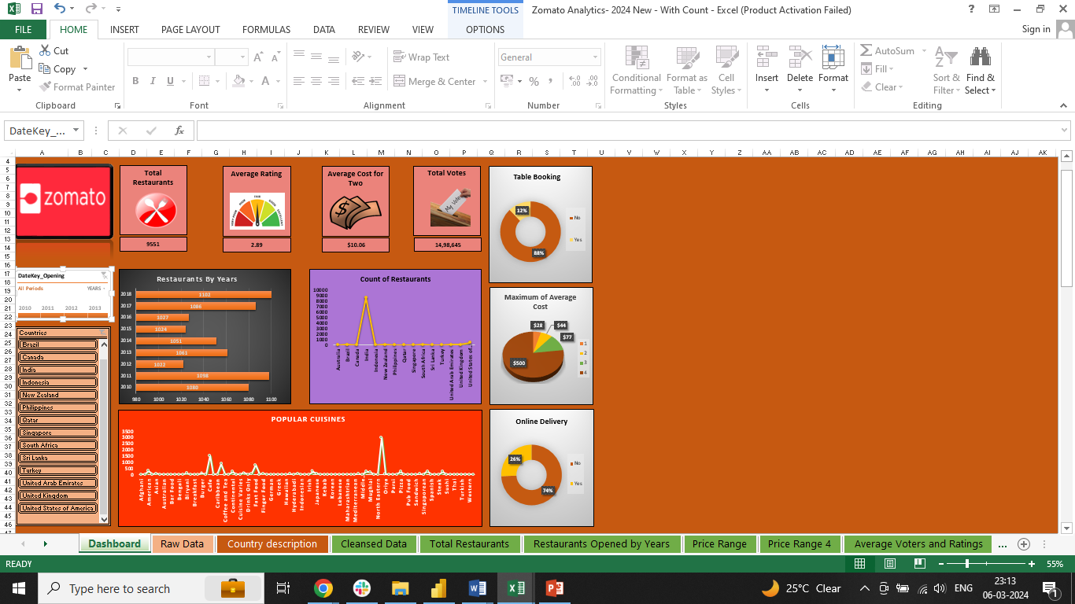
Dashboard

Slide 12

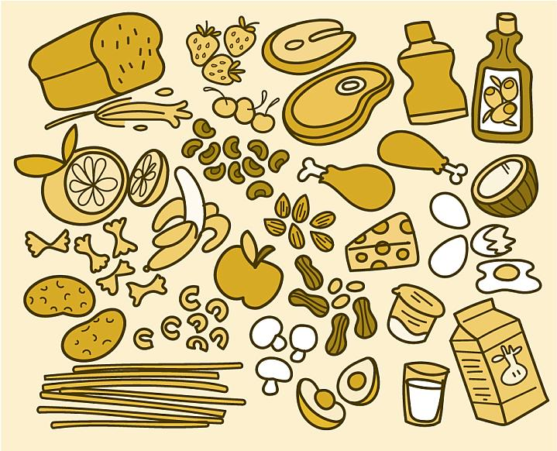
Conclusion
Popular Indian cuisine is North Indian owing to major North Indian cities and for the USA it’s all American food.
India and US have moderate food prices as compared to the rest of the countries.
We can check number of restaurants established year wise using interactive slicers.
Positive relation exists between ratings and the average cost for two, this could be because of the assumed notion that premium restaurants have good ambiance or better service, whereas regular restaurants cannot provide such an experience which could lead to lower ratings.
Provide reservations and online delivery to receive valuable customer feedback and rating.

Slide 13


